Slide 1
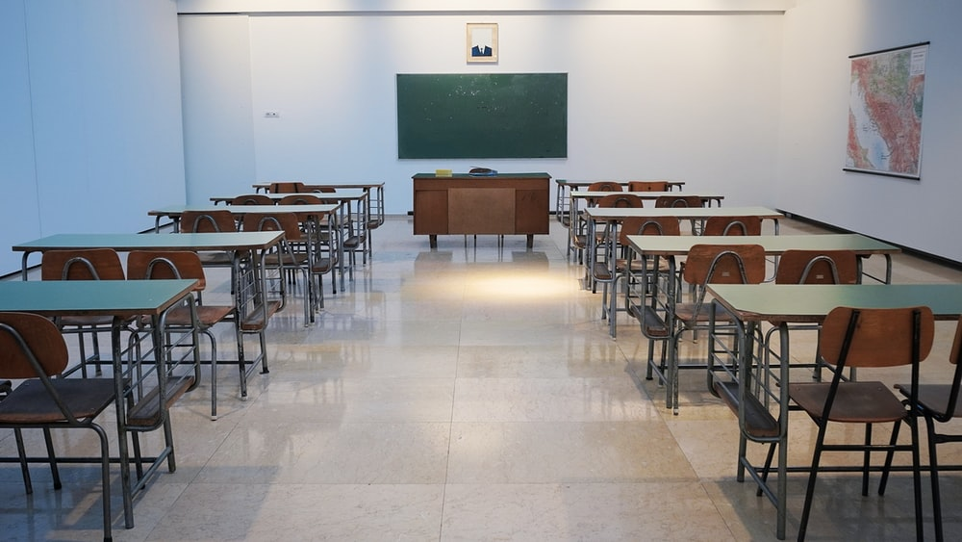

21st Century Skill Sets for Teachers

Slide 2


Slide 3
21st Century Skills (3Ls)
Learning Skills (4Cs)
Critical Thinking
Creativity
Collaboration
Communication
Literacy Skills (IMT)
Information Literacy
Media Literacy
Technology Literacy
Life Skills (FLIPS)
Flexibility & Adaptability
Leadership & Responsibility

Slide 4
Learning Skills
Observing and analyzing the problem
Understanding the reasons
Evaluating the reasons
Taking the right solution

Slide 5



Learning Skills
Thinking out of the box
Generating innovative ideas
New Inventions
Curious, passionate and realistic

Slide 6
Learning Skills
Contributing knowledge and ideas
Connecting idea, thoughts
Better outcome

Slide 7
Learning Skills
O1
Sharing information
02
Expressing thoughts and opinions
03
Verbal, non-verbal, visual, writing

Slide 8

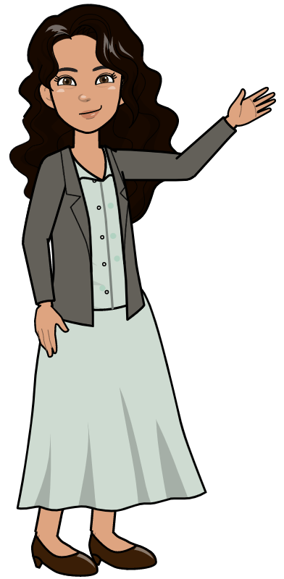


Slide 9
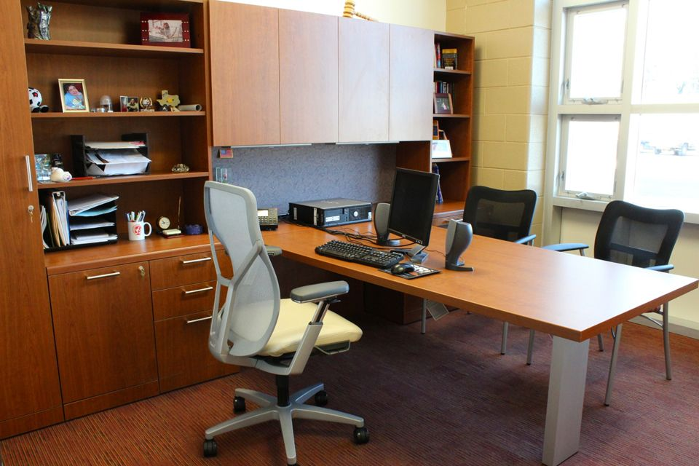
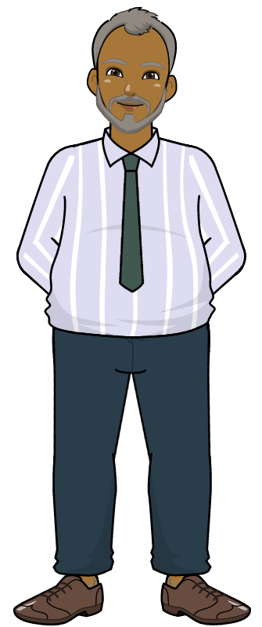

Slide 10
What is Media Literacy?
Media Literacy is the ability to access, analyse and evaluate the information gathered through different media.

Slide 11
Literacy Skills
Evaluating the information critically
Using information effectively

Slide 12
Literacy Skills
Understanding media (print/non-print)
Publishing the information

Slide 13
Literacy Skills
Accessing information
Knowledge of different gadgets

Slide 14





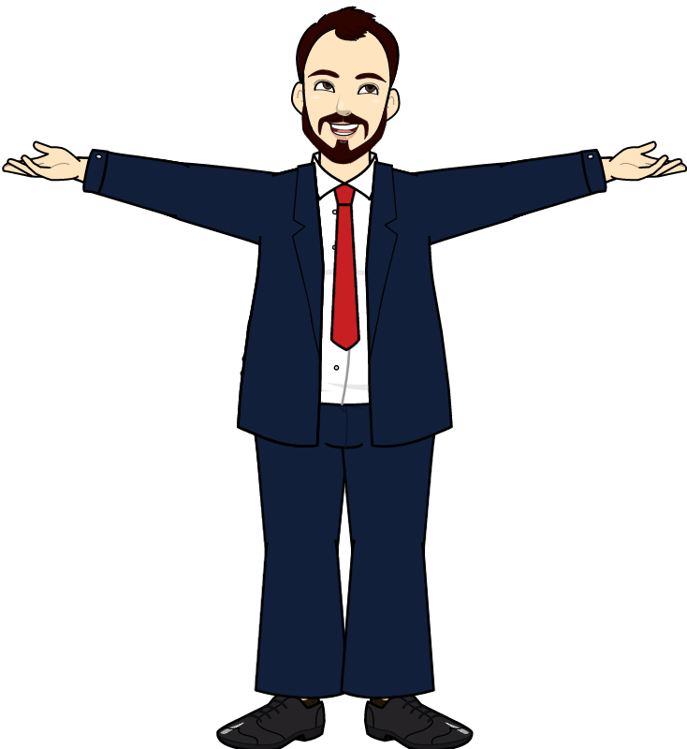
Life Skills
Flexibility and Adaptability

